Slide 1
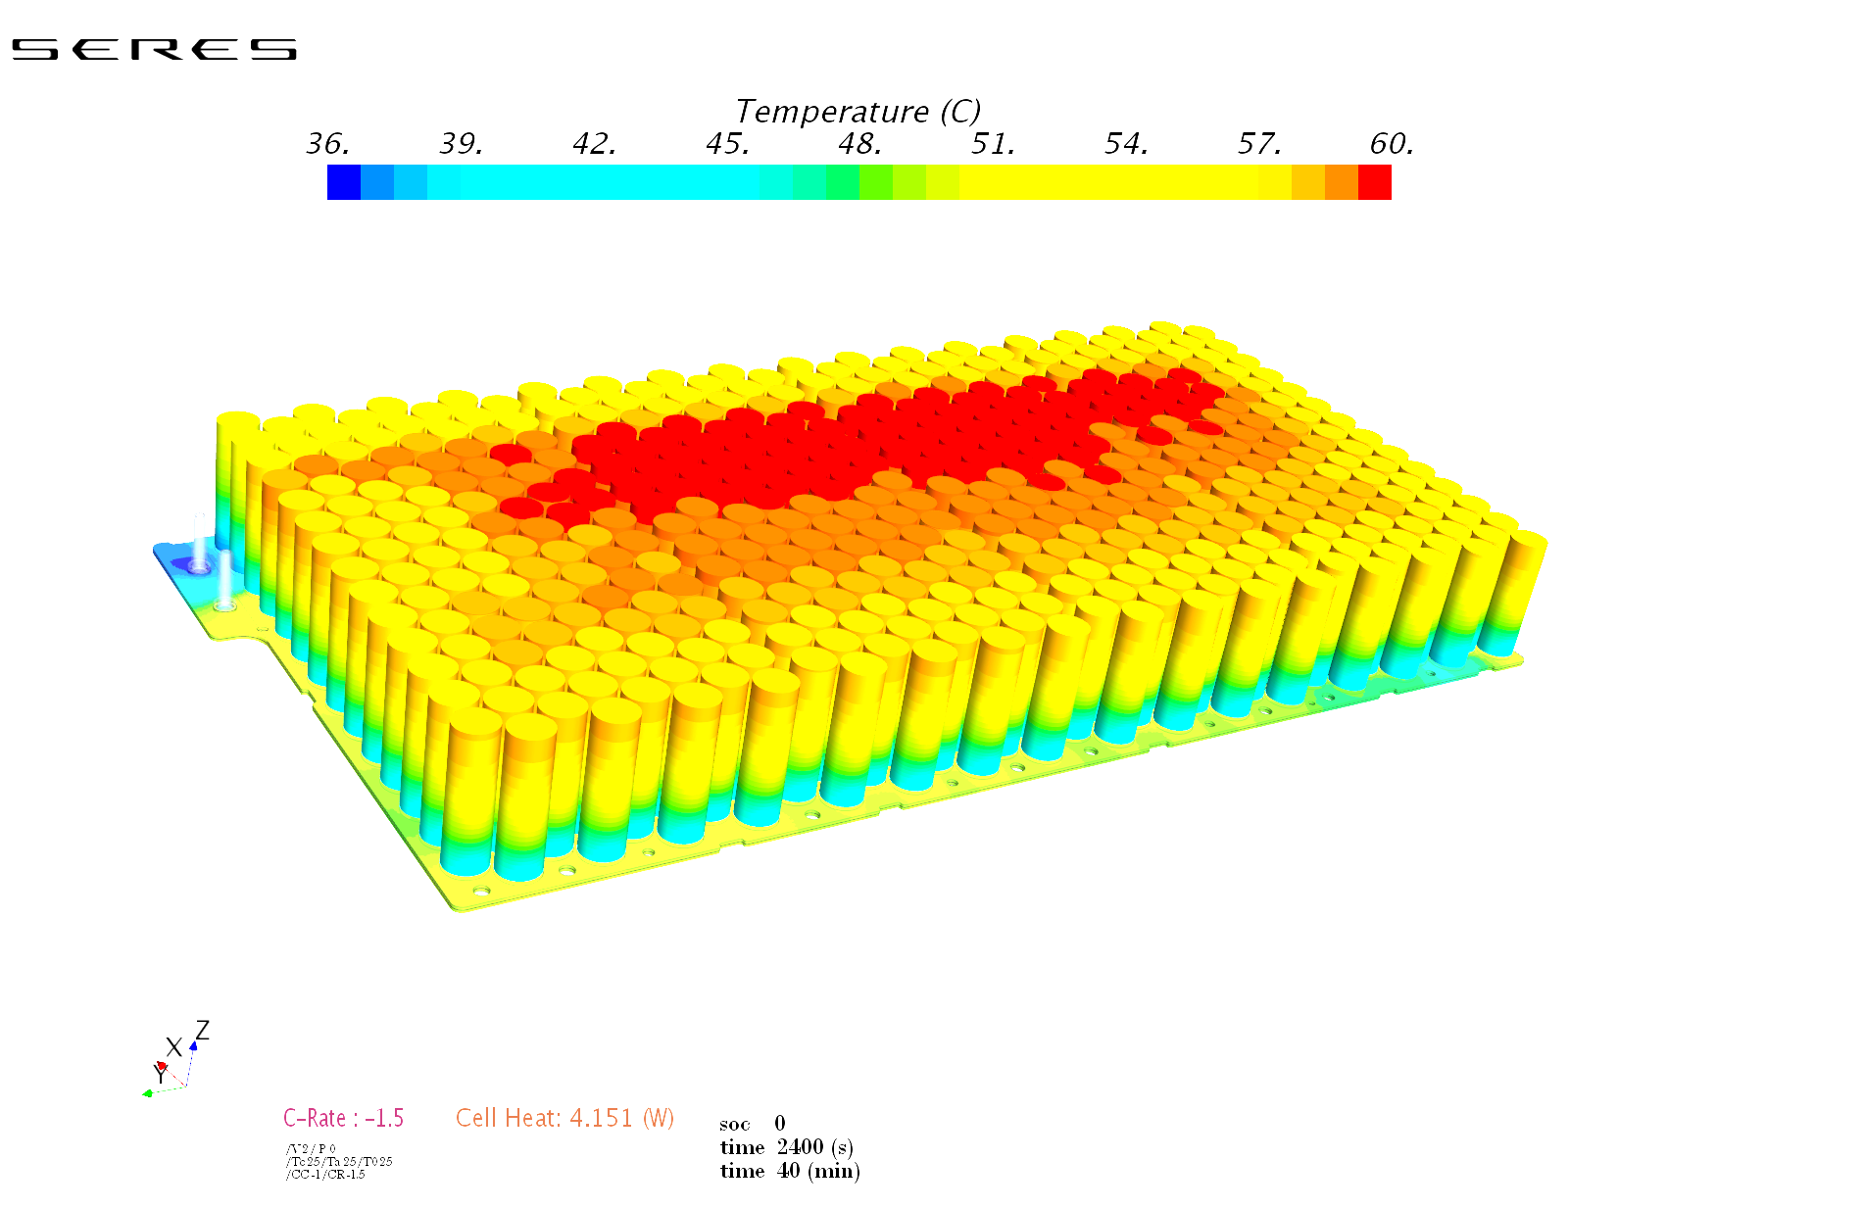
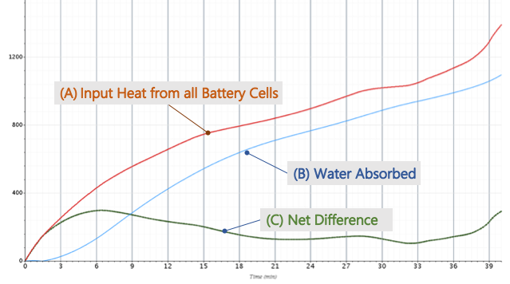
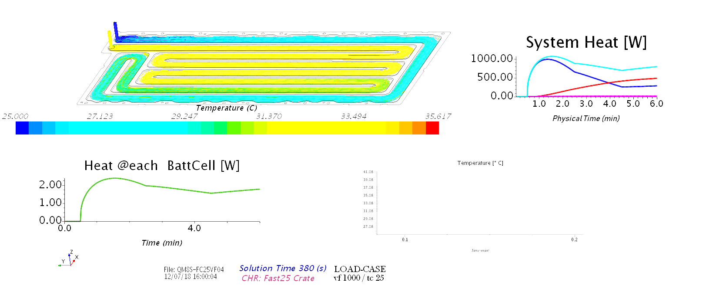
effectiveness of battery module
SF Motors 2017-19: I devised a novel method of CFD (starccm+) to model the conjugate heat transfer through a BEV’s high-voltage battery module. It comprised battery cells (Fig 1a), the metal plate and the liquid coolant (Fig 1c). The heat input [A] from the cell conducted through the metal plate and absorbed [B] by Water-Ethylene-Glycol coolant (WEG) and diverted away convectively. After some heat emits to the ambient air, the remainder is “Net Difference” [C] or Accumulated Heat.
Fig 1a
Fig 1b
Fig 1c
As WEG absorbs heat its temperature rises from cool blue at the inlet to warmer yellow.

Slide 2
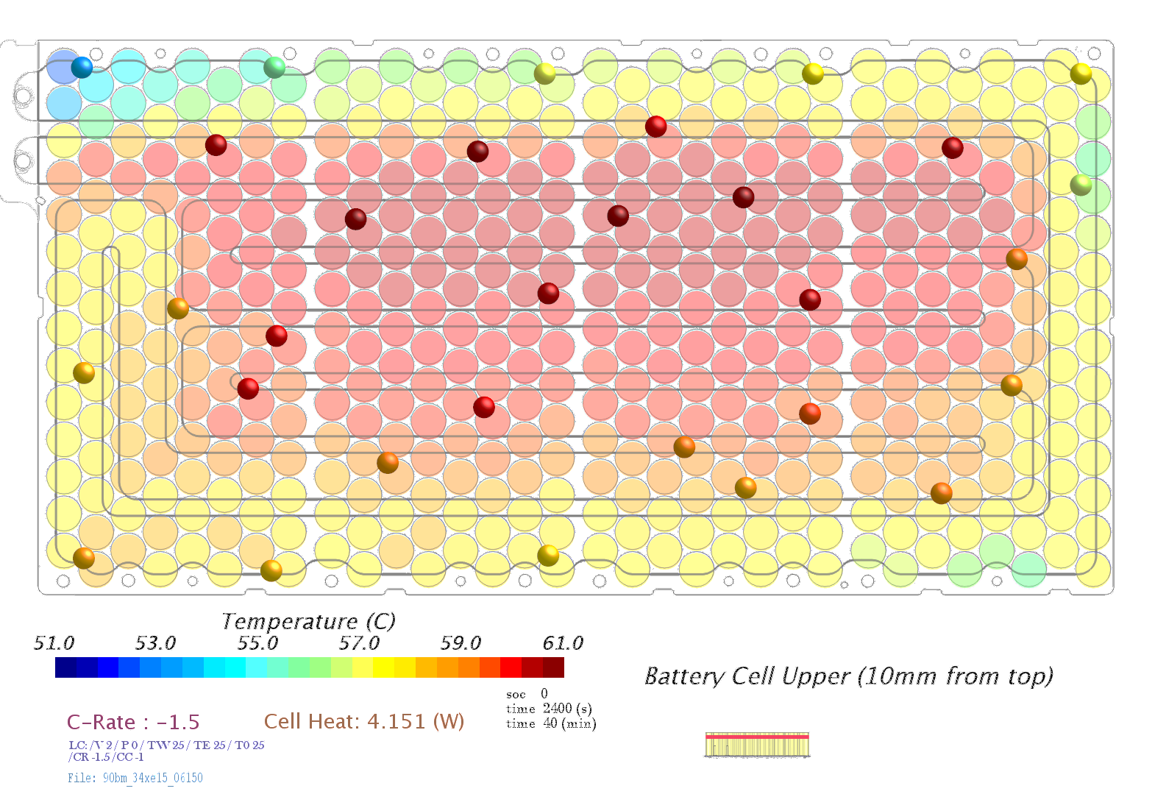
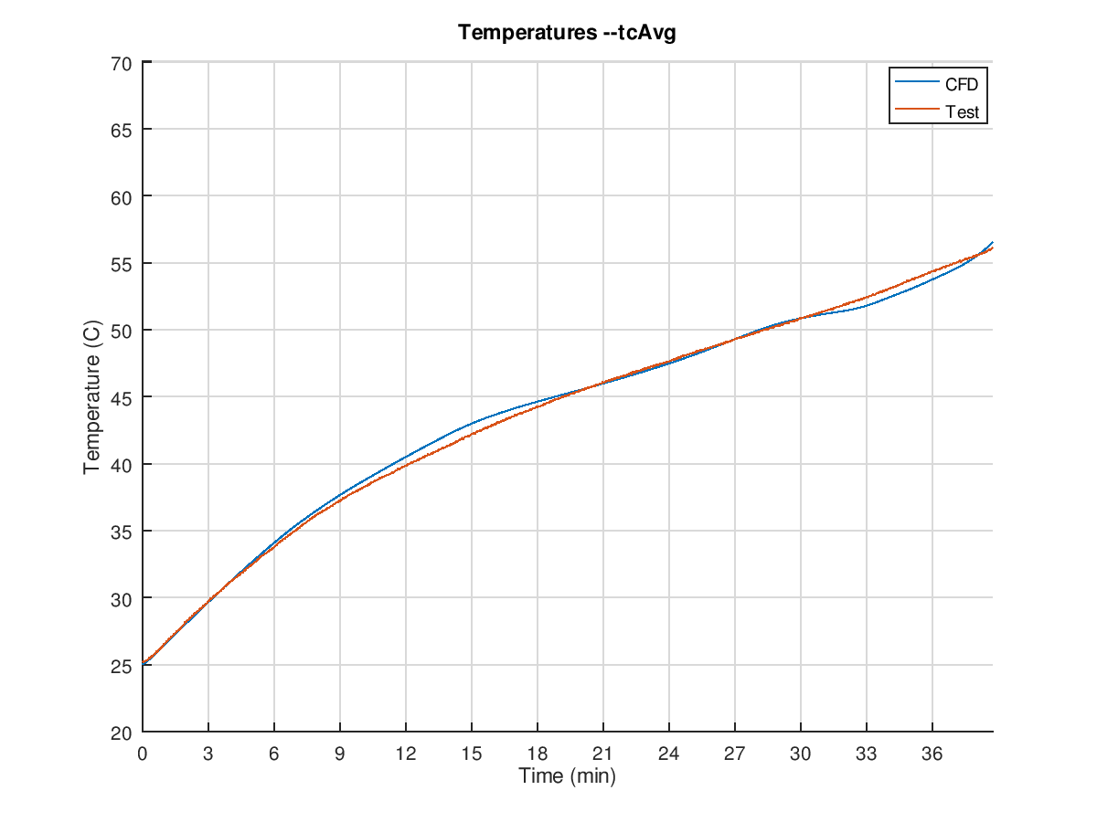
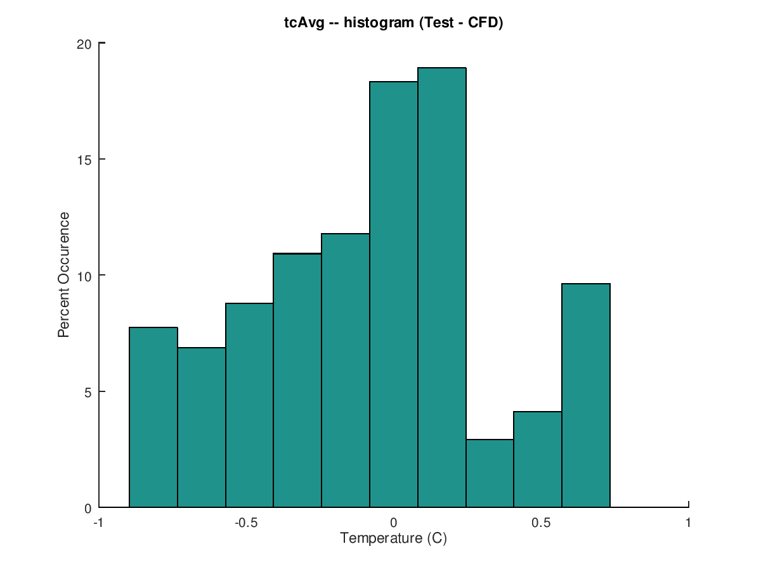
validating cfd model with thermocouples
The accumulated heat results in temperature rise each varying due to the specific effective heat rejections and columbic losses of cell. The prototype instrumented with 40 thermocouples, represented as probes Fig 2a, validated the CFD model.
Fig 2b
Fig 2a. Thermocouple locations pinned as probes embedded in CFD model’s heat map.
Fig 2c
To evaluate the quality of validation, I processed the test data with Matlab quantifying how tightly the CFD fit with test data during charge cycle Fig-2b. Fitness was qualified by sampling (Fig-2c) the Temperature Differential between CFD and Test-rig scoring: 85% (1.5·sigma) within 0.5K; 93% (2·sigma) within 0.75K; and 100% of samples within 1K deviation.
Validating CFD against Prototype: charge cycle (2b) histogram (2c)

Slide 3
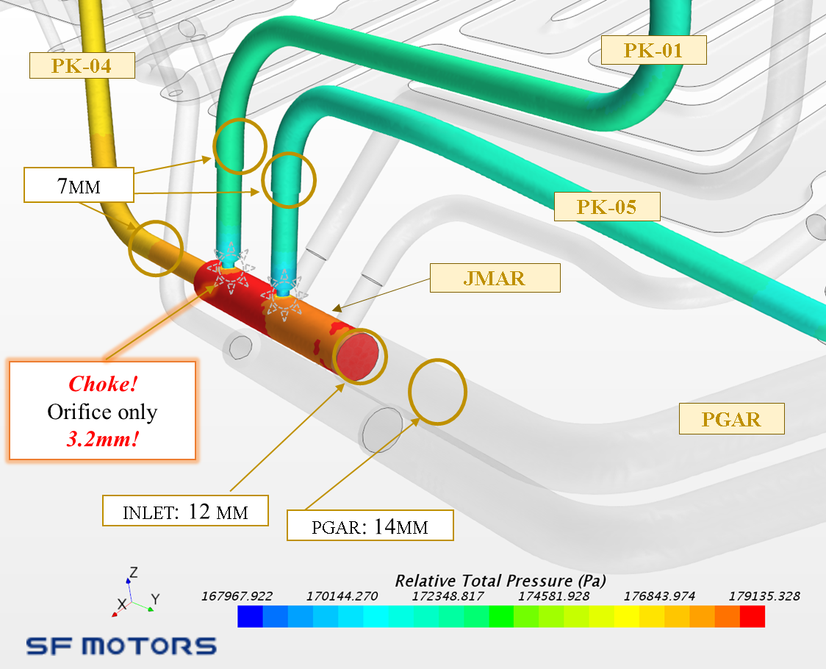
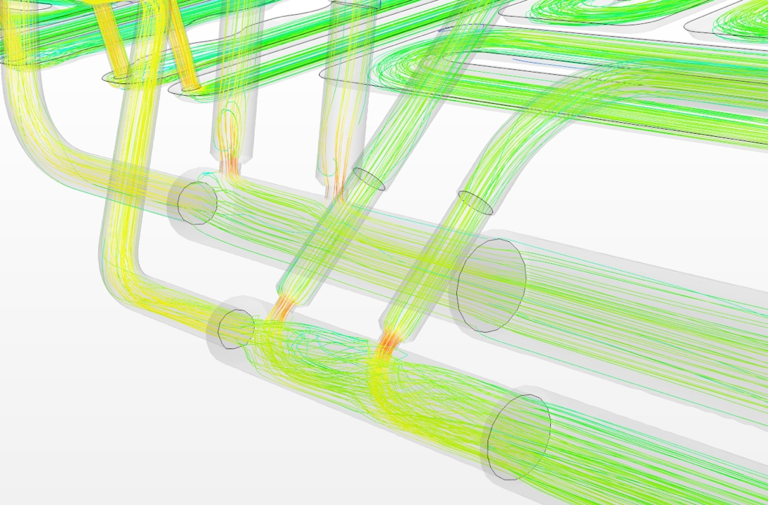
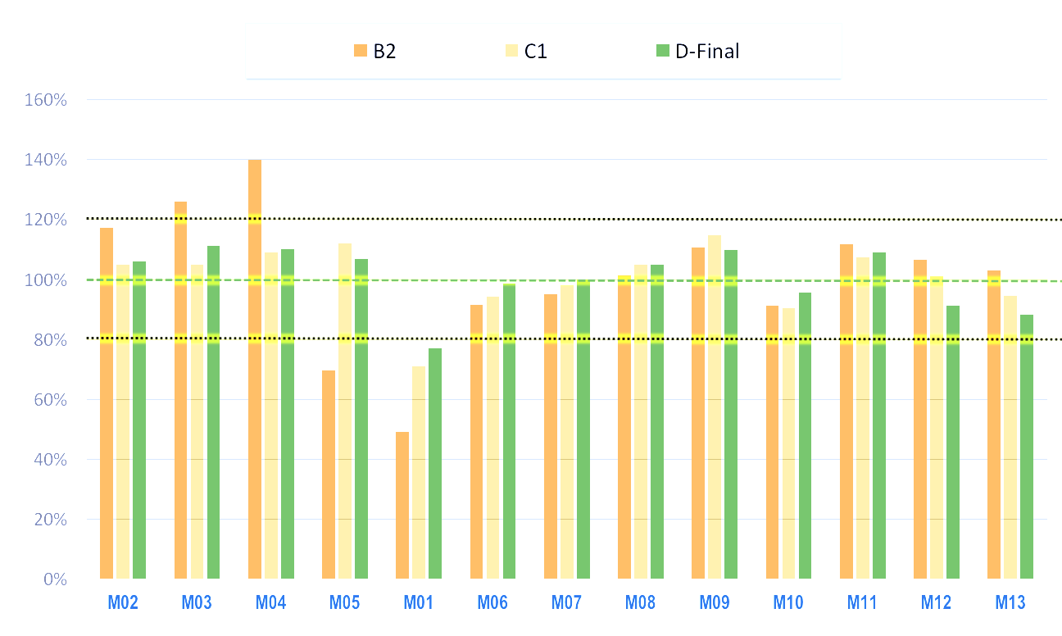
balancing water flow in battery pack
Water-Glycol (WEG) flowing through the battery pack was modeled by CFD (starccm+). Studies at module level determined the targeted flowrate and tolerance range. The model addressed many impairments such as identifing choke points (Fig 3a) where the orifice reduced by 60%. The final design released for hard-tooling obtained balanced tuning: flow to each module within 20% of the target (Fig 3b).
Fig 3a
Fig 1. Choke Points
Fig 3b Flow into each module relative to Target
120% 100% 80%

Slide 4
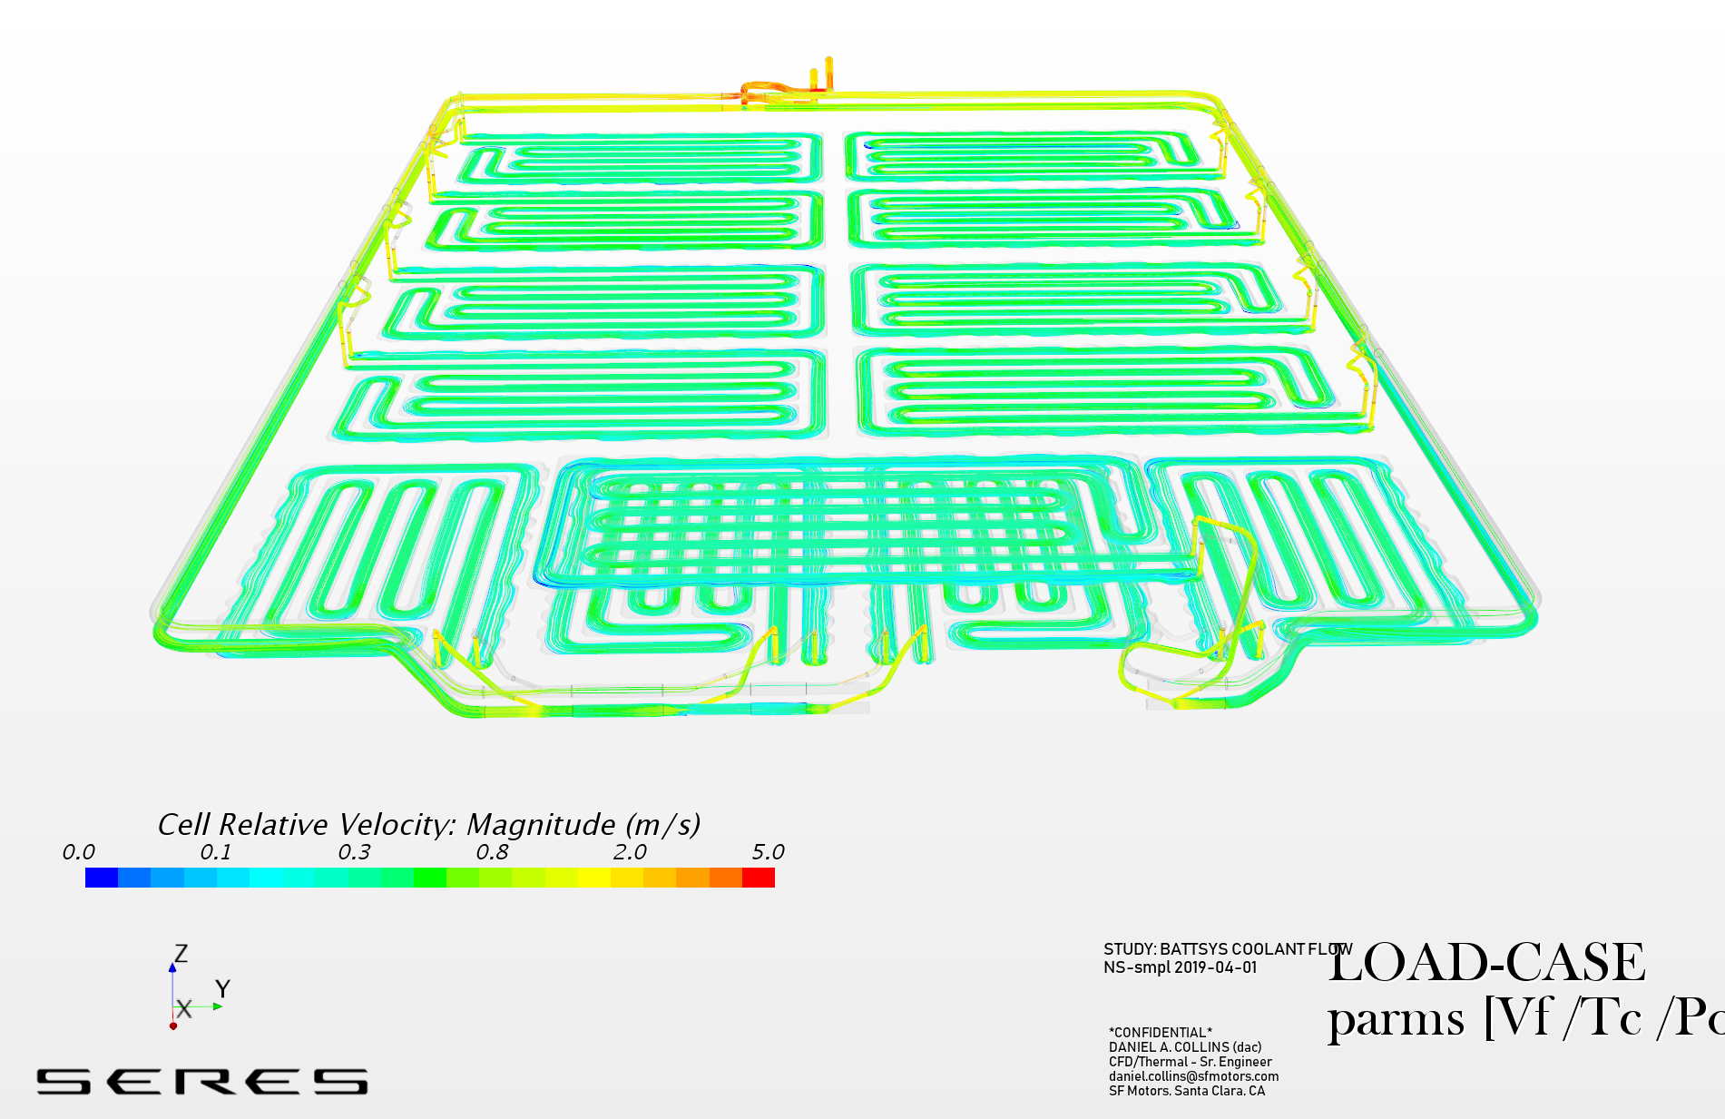
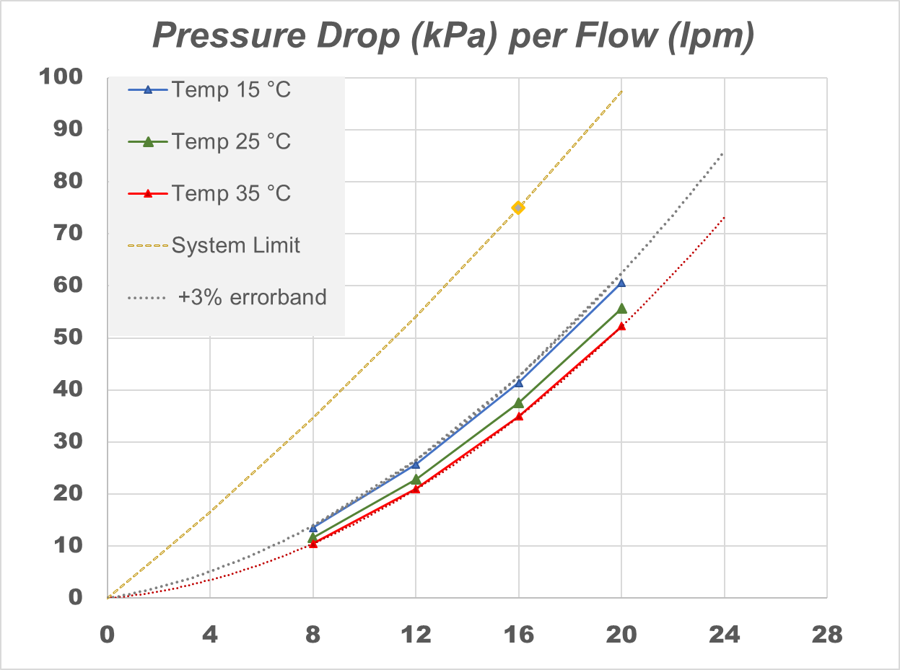
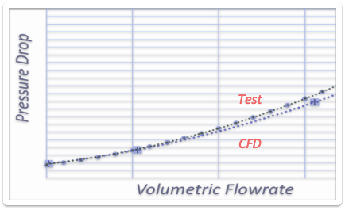
system pressure drop in battery pack
Fig 4a
The system pressure of the CFD model (Fig 4a) was qualified against B-sample tests (Fig 4b). The qualified model calculates the pressure loads of the coolant circuit in the battery pack for many more generations, forecasting its conformance with the “system limit” at many more flowrates and temperatures (Fig 4c).
Fig 4c
Pressure drop per Flowrate, Temperature
Fig 4b
Pressure-drop, CFD and Test

Slide 5
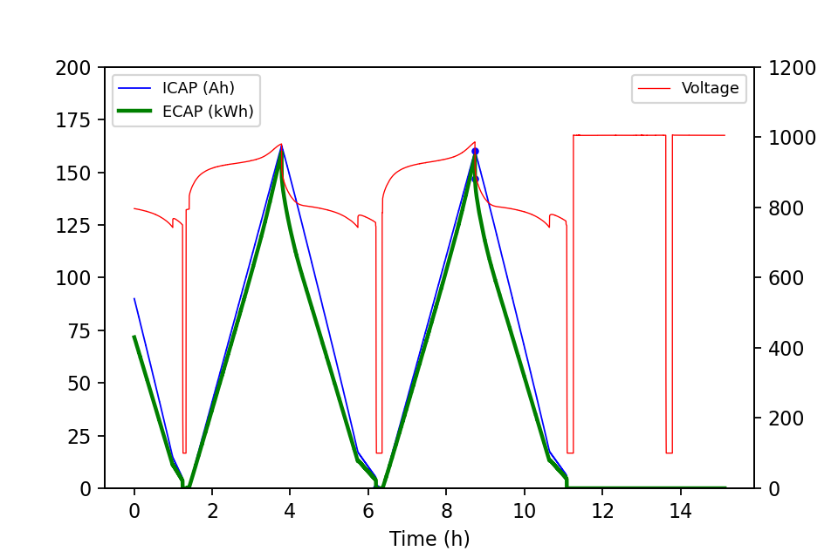
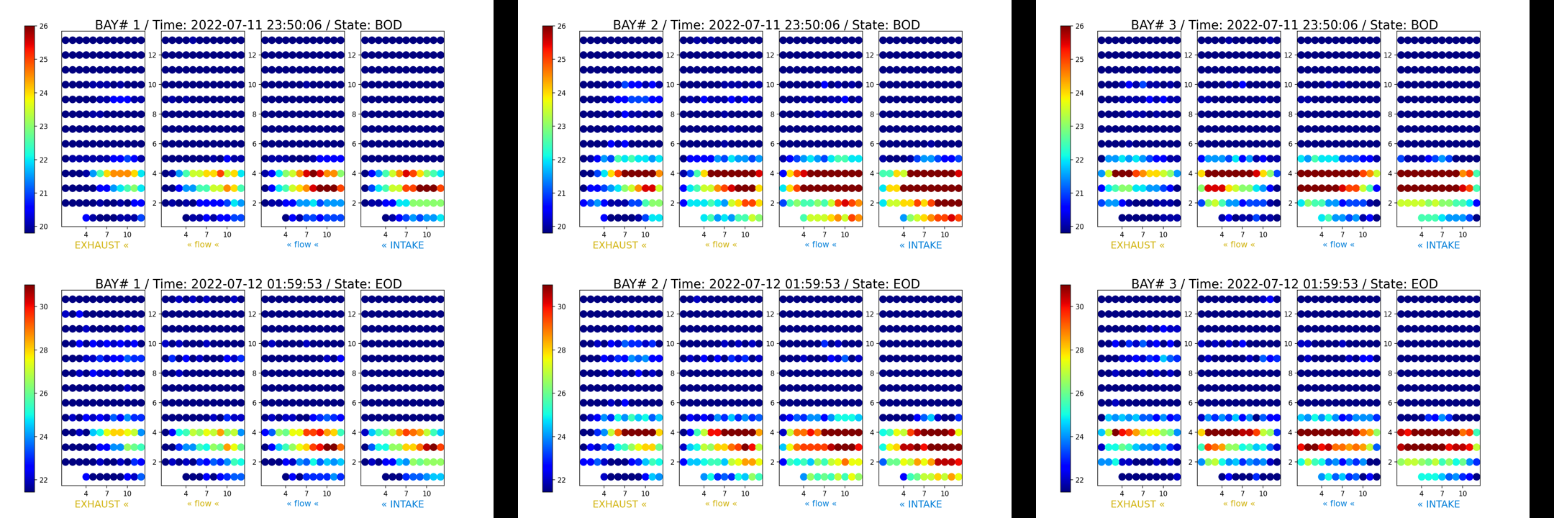
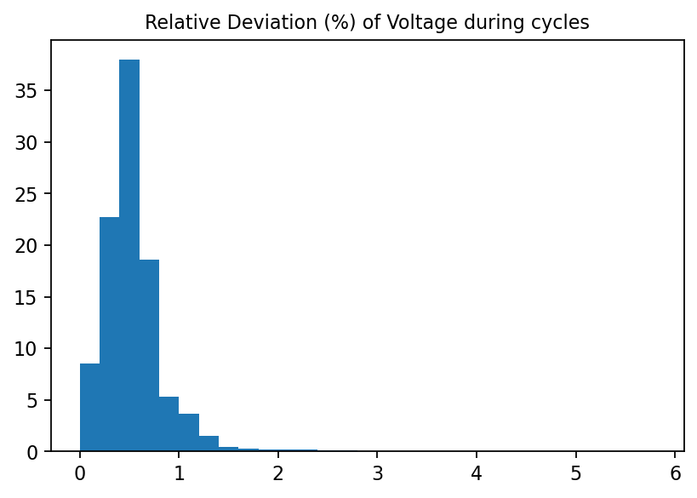
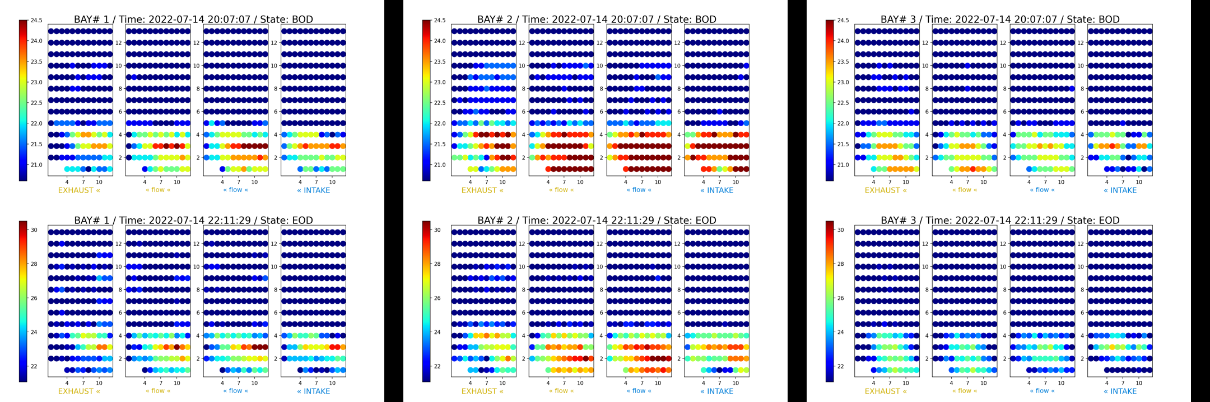
characterizing bms with python
At Enevenue (2021-23): my Python analysis processed BMS telemetry, first identifying SoC Keys during charge profile (Fig 5a), such as End of Charge (EoC) and End of Discharge (EoD). Heat maps at EoD measured the flatter thermal gradients after installing air shrouds (Fig 5b, 5c) and intake louvers. It also assessed voltaic imbalances (Fig 5d) that impacts string’s energy efficiency.
Fig 5a Identifying SoC Keys
Fig 5b Before Air-Shroud
Fig 5d Voltaic Imbalances
Fig 5c After Air-Shroud

Slide 6
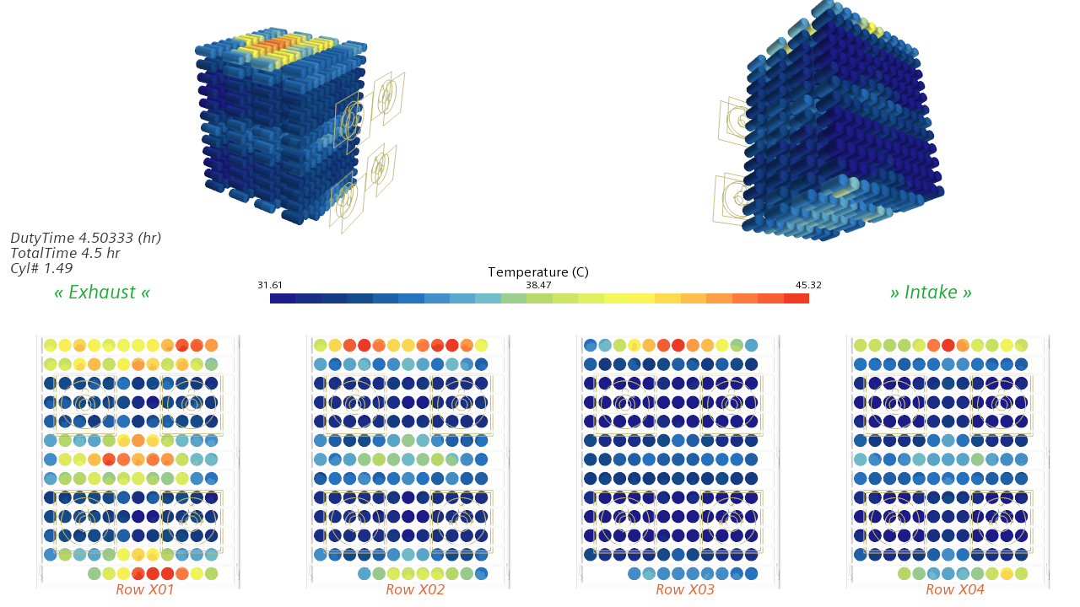
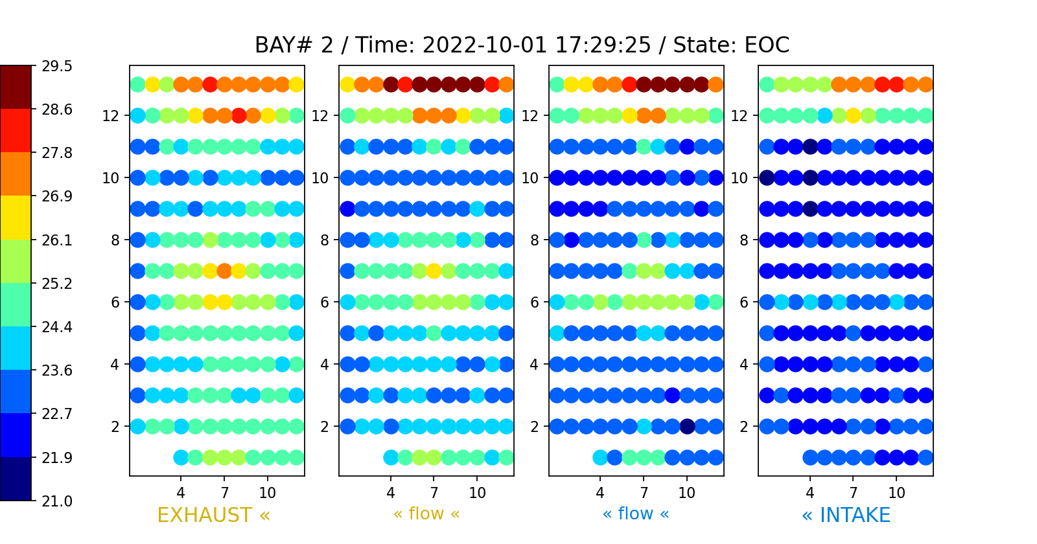
discrete celss in large battey pack
Temperatures of each cell compared by CFD prediction against battery pack (Enervenue). CFD modeled with starccm+; battery cells processed with Python.
Fig 6a Cell temperature Predicted by CFD
Fig 6b Cell temprature Reported by BMS

Slide 7
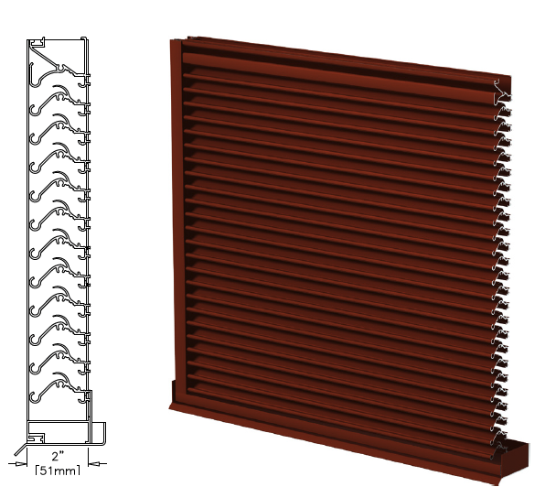
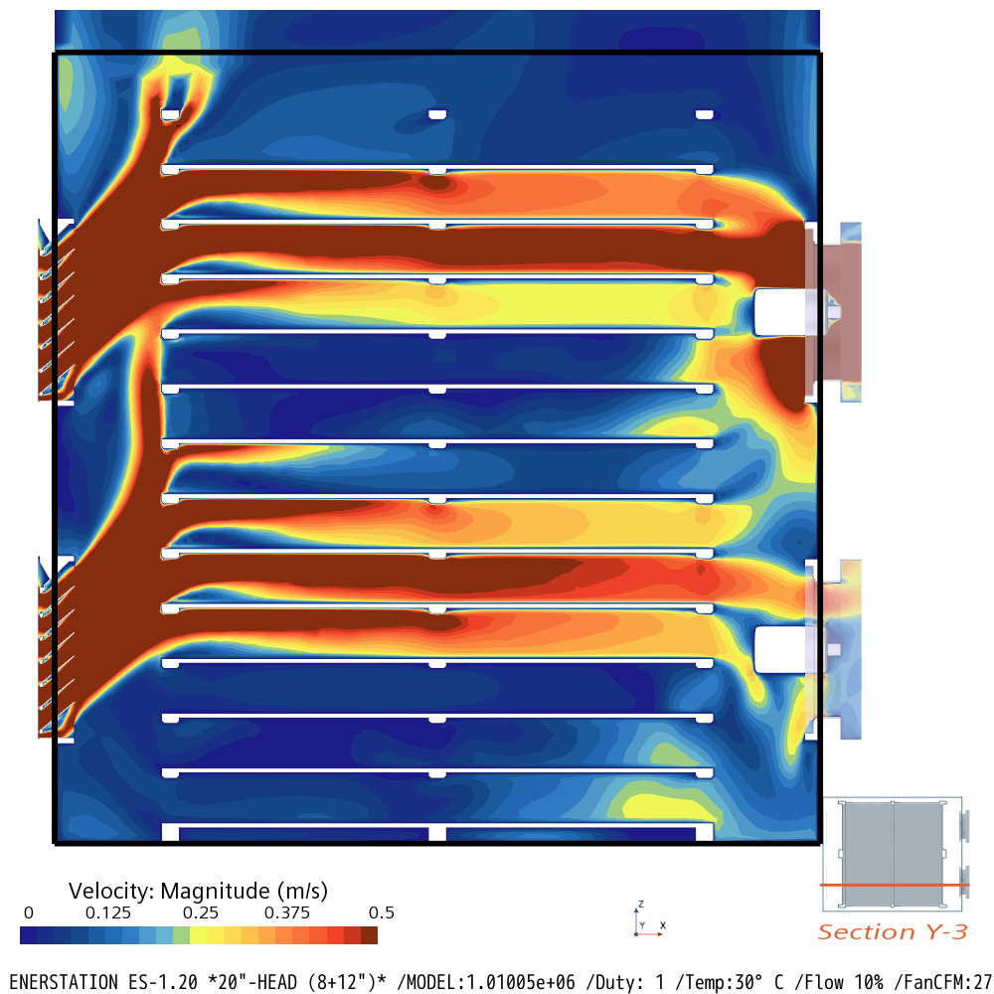
selecting louvers, enervenue
My CFD model predicted the effect of air flow through the first louver (Fig 7a): the air deflects upwards starving lower rows of cool air. The second louver (Fig 7b) corrected the orientation of air, reduced the temperature variation, and improved the cooling effectiveness. Furthermore, the second louver provided greater ingress-protection against rain and environmental hazards.
Fig 7b. Second louver
Fig 7a. First louver, CFD model

Slide 8
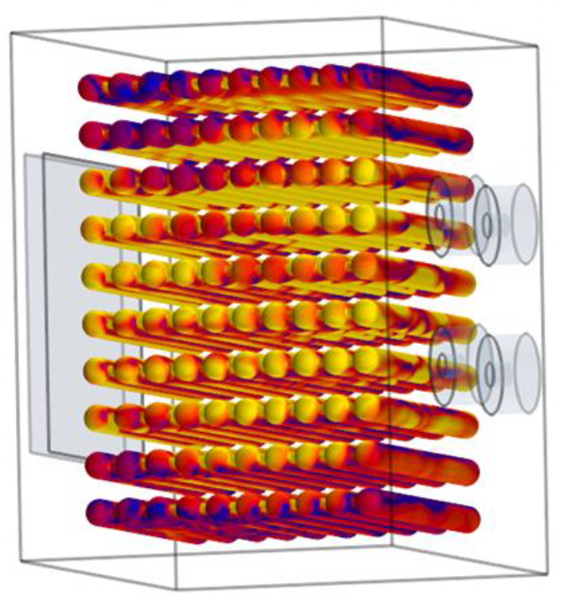

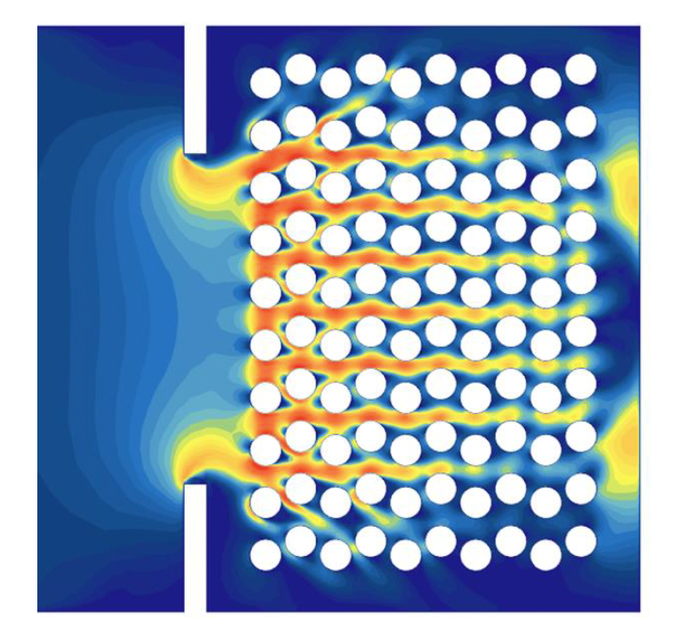
patterned arrangements
My CFD model predicted the effect of air flow through the patterend configurations with varying staggered layouts. The results shaped the system requirements.
Fig 8a. Temperature of vessels in simple pattern
Fig 8b. Air flow through staggered pattern
~ Animated

Slide 9
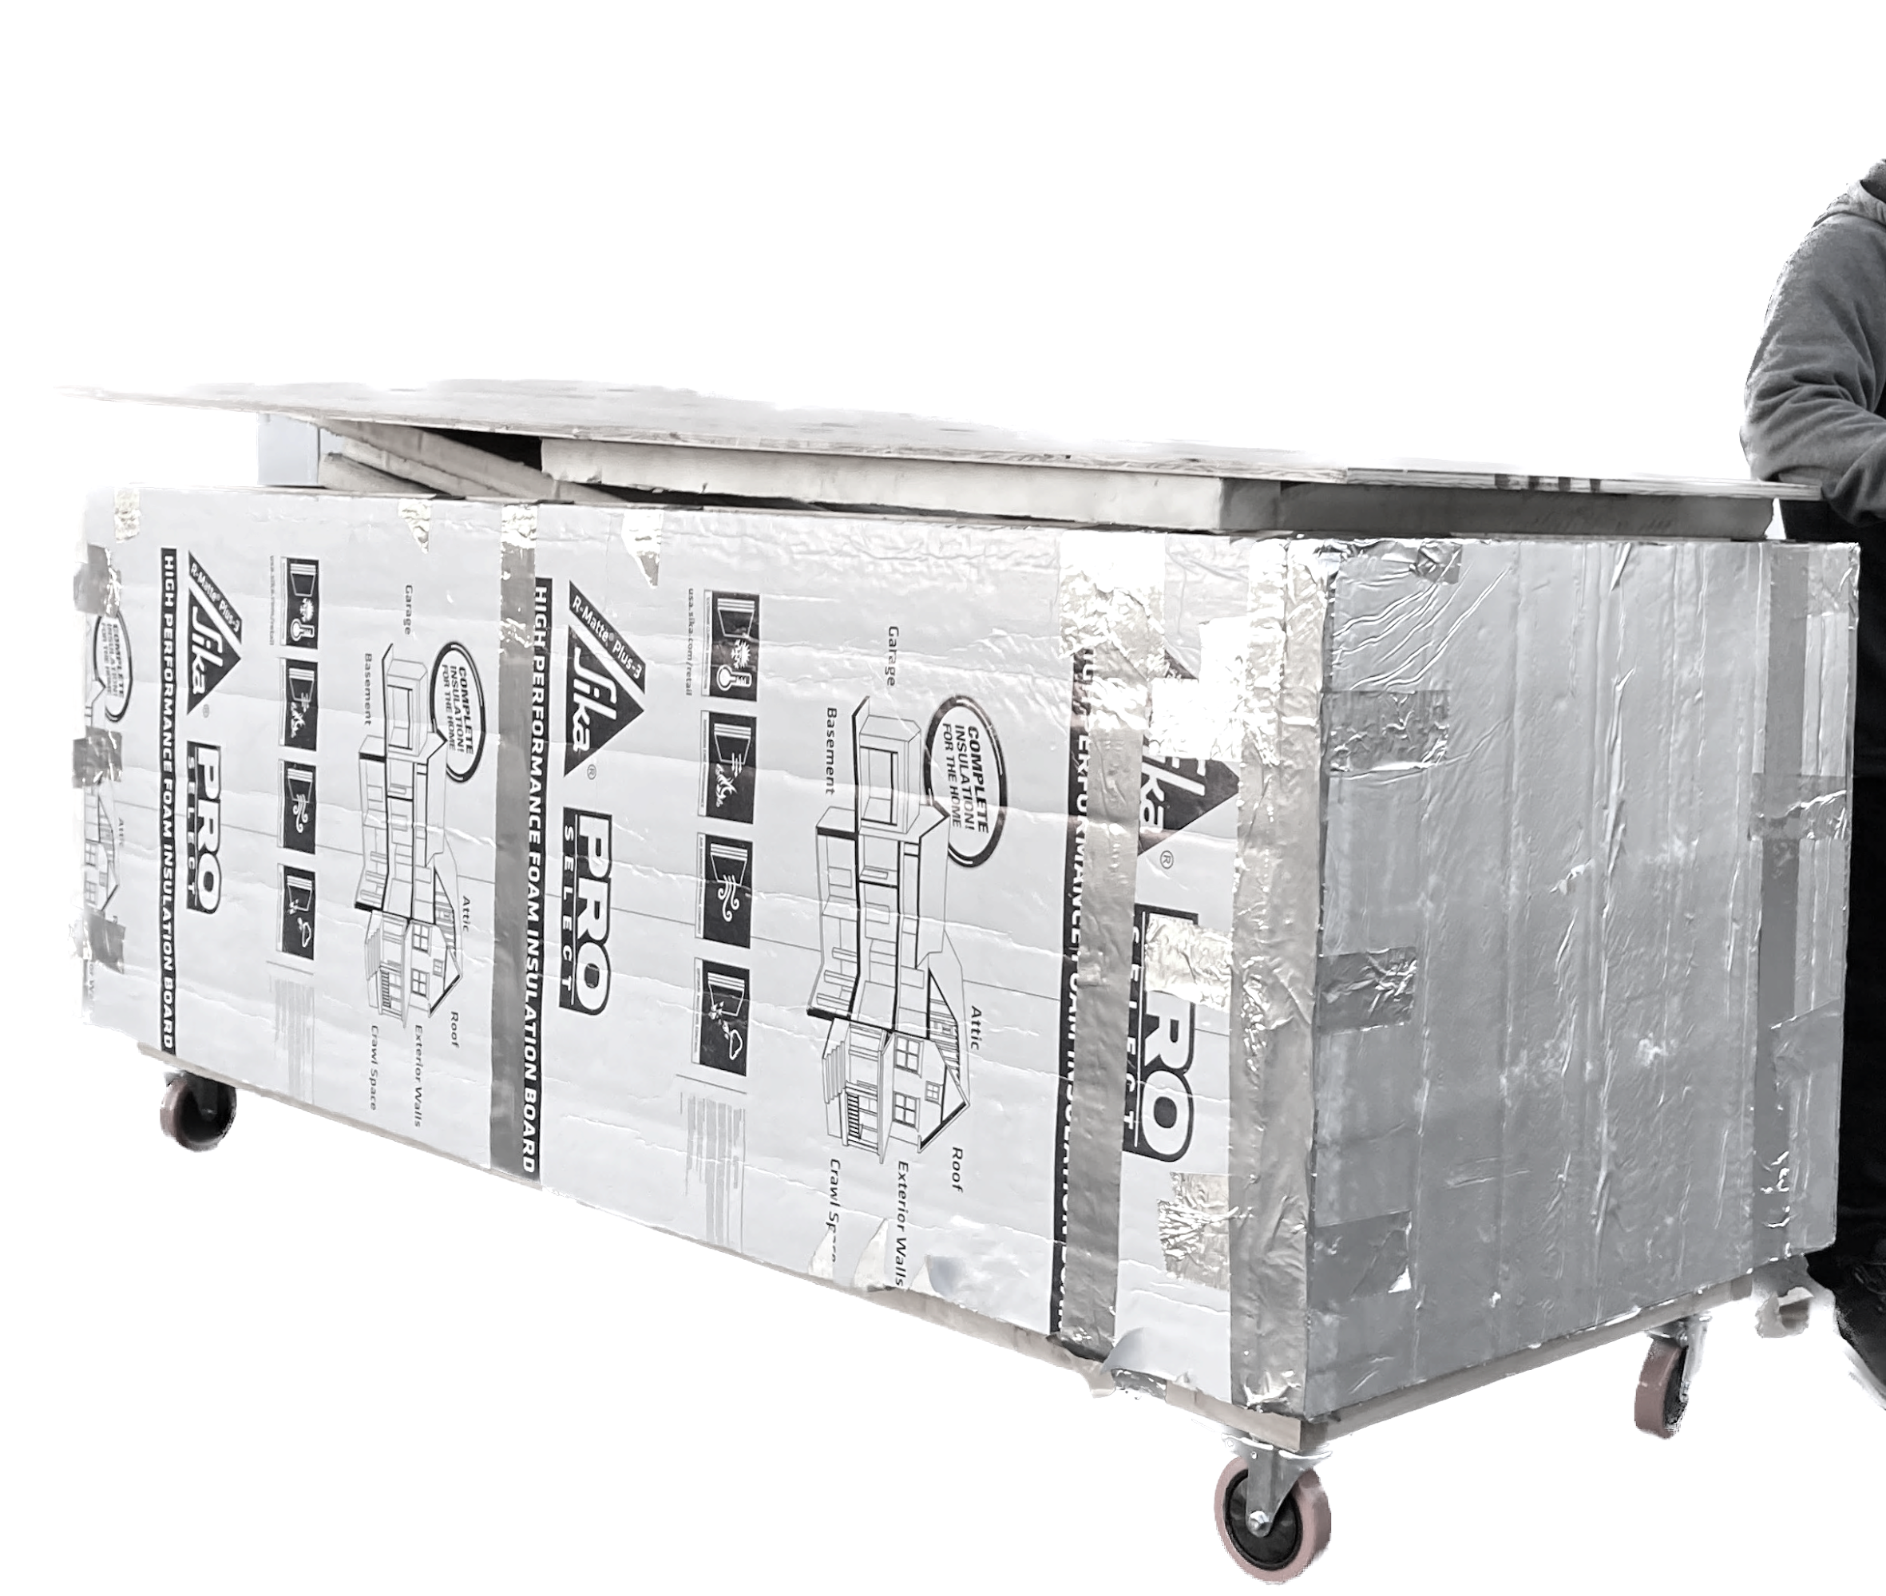
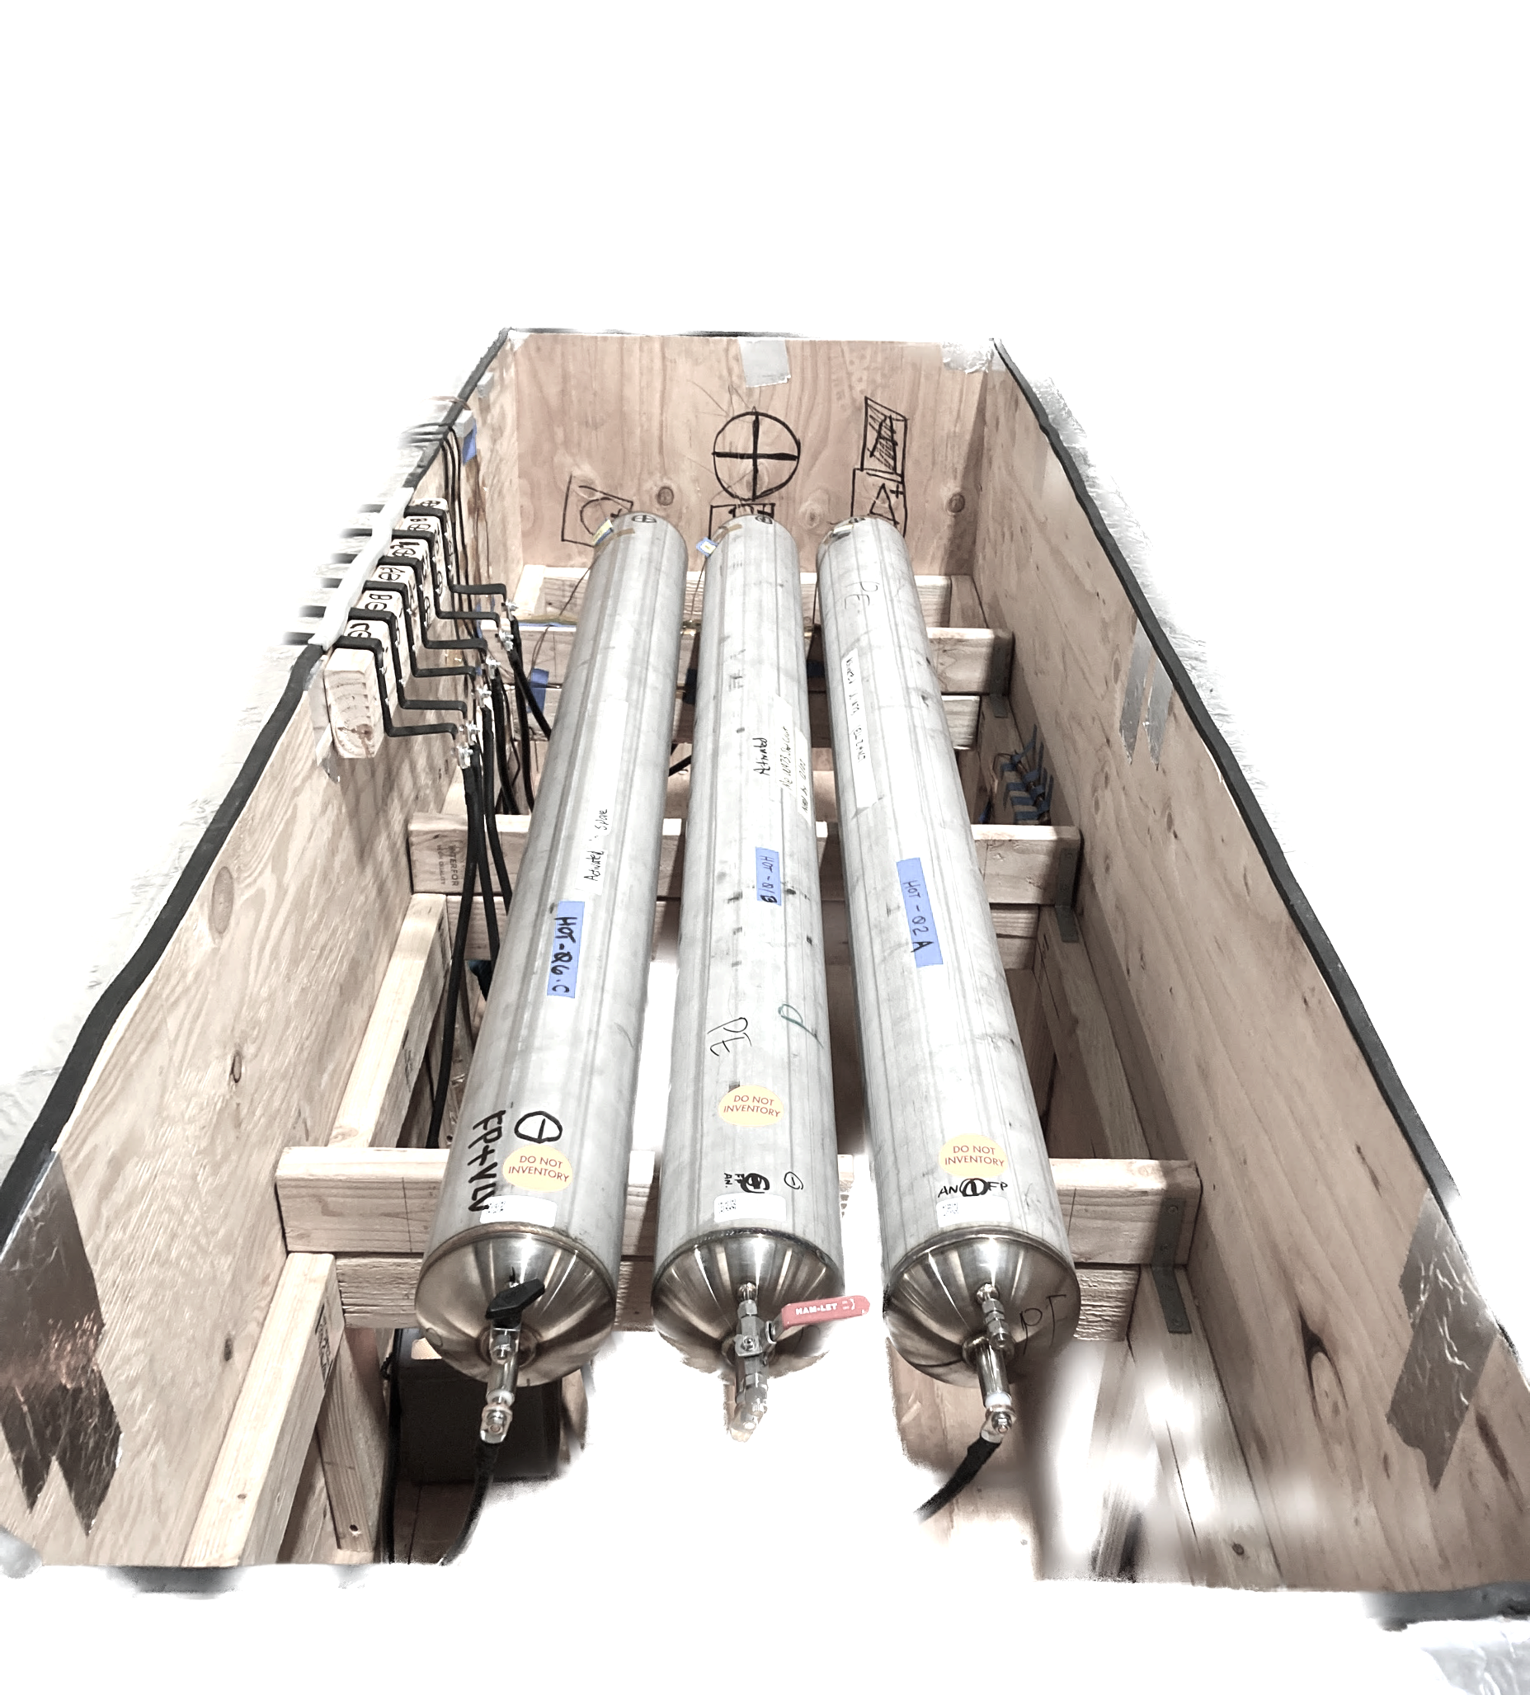
hot box for product certification
I constructed a “hot box” (Fig 9a) to fit the 2m long vessels (Fig 9b), applying air at 50℃ while charging the vessels, to facilitate the “conditioning of vessels” per UL ¹⁹⁷³. Rather than booking a 10ft walk-in-chamber, this nimble box equipped with two 1200-W electric heaters, one desktop fan, and two louvers fulfilled the task for only $1000. The conditioning box was approved and accepted with the UL submission.
Fig 9a
Hot box facilitating UL 1973
Fig 9b
Long vessels require custom hand-constructed coffin box

Slide 10
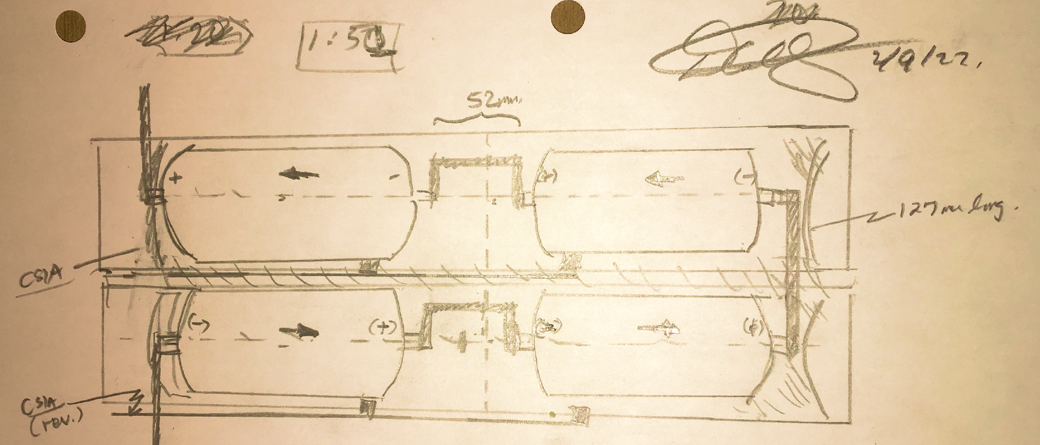
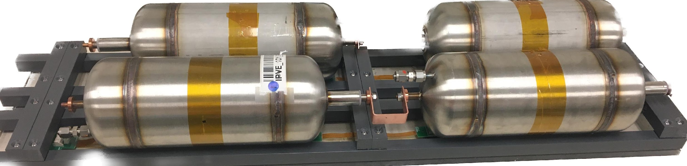
creative prototyping solution
We encountered major issue with the first module necessitating a fast alteration. The prototype I sketched (Fig 10a) and fabricated (Fig 10b) was selected in our pugh analysis as it both served the mechanical design and utilized the available BMS. Within a month of the incident, the battery pack was retrofitted with the new trays and resumed successful cycling.
Fig 10a. Sketch of module prototype
Fig 10b. Assembled Module Prototype called “Duplex Tray”

Slide 11
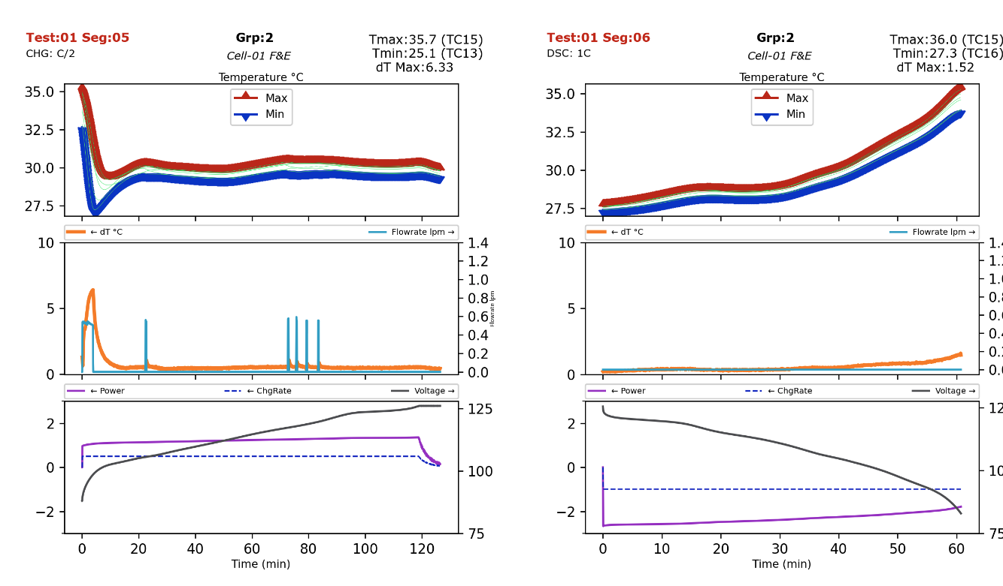
battery analysis
At Wisk I analyzed the performance of the battery module and compared it against targets, measuring thermal gradients and identifying sensitivities. My python generated succinct and informative slides, for each load case plotting the temperatures, coolant flowrate, and the driving power loads, and annotating key metrics. I utilized python library to automate the generation of the slides for the 1200+ slides. The performance was tabulated and thesingle slide executive summary presented at design review in front of chief engineers, offering recommendations based on the analysis.
Fig 11a. Condensed Summary Slides

